Slide 1
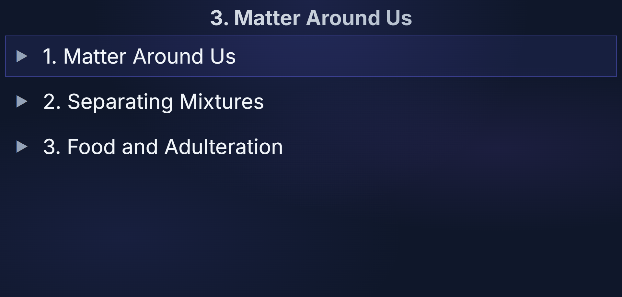

Class 10
Science
3. Matter Around Us

